Slide 1

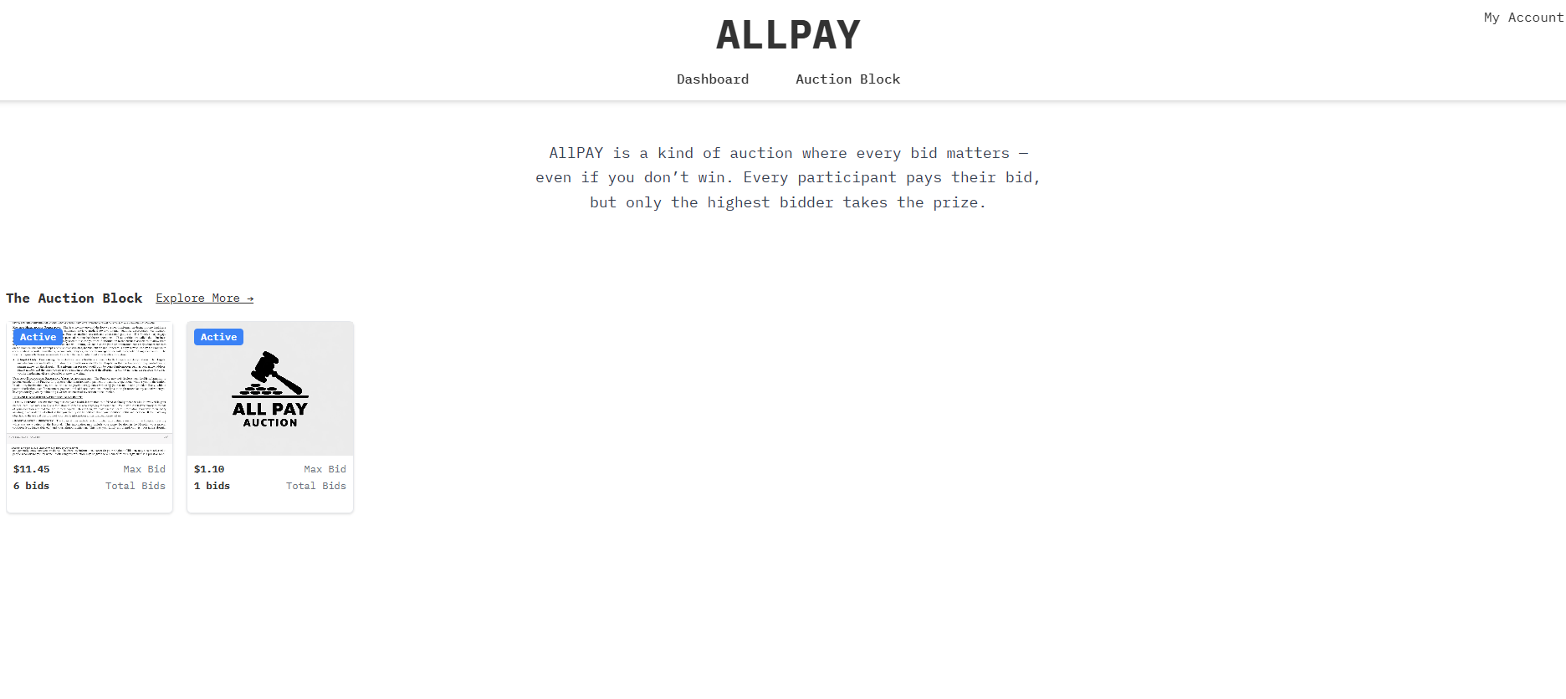

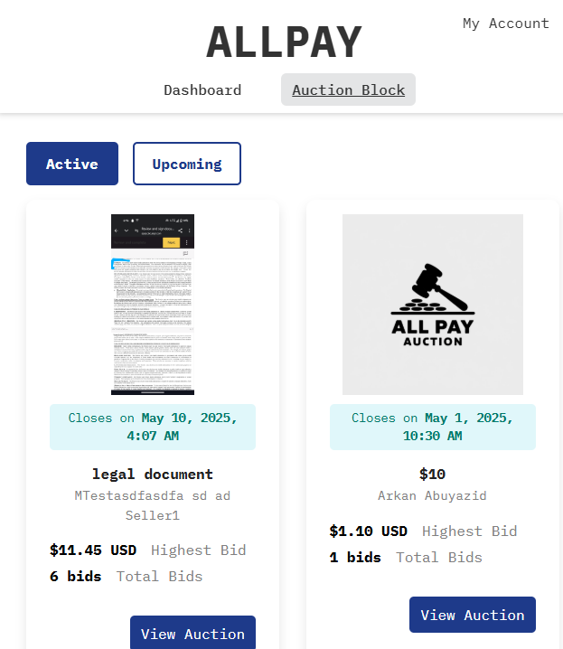
All Pay Auction
Arkan Abuyazid
Jason Le
Praewa Pitiphat
Steve Wang

Slide 2
The Problem

Slide 3
Problem statement
“Our goal is to create a robust and user-friendly platform that facilitates these All-Pay Auctions between sellers and buyers.”
This project implements an All-Pay Auction system, a unique auction mechanism where every bidder pays their bid, regardless of whether they win the item. This contrasts with traditional auctions where only the winner pays.

Slide 4






Technology Stack
Programming Language: Ruby 3.3
Backend Framework: Ruby on Rails 7.2
Frontend: HTML/CSS/JS
Database: PostgreSQL (PSQL)
Version Control: Git
Containerization: Docker

Slide 5
Design and Website Overview

Slide 6
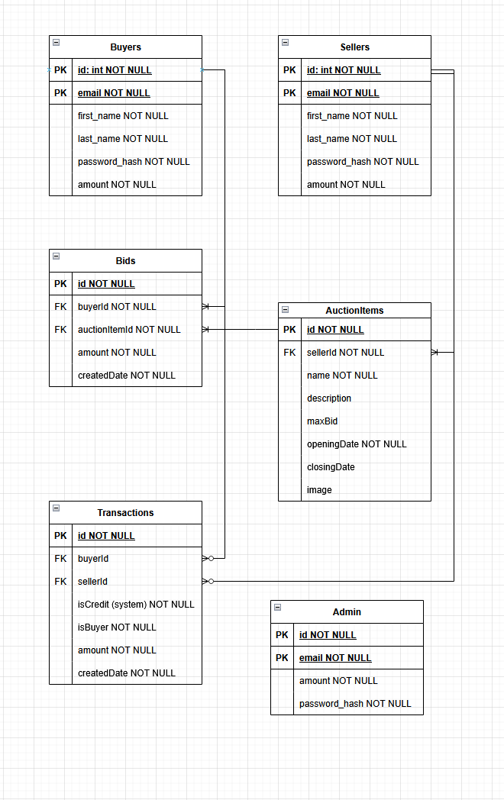
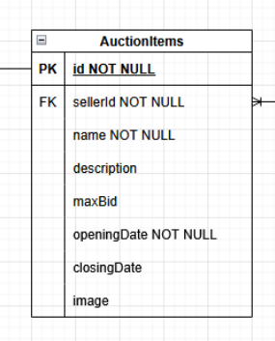
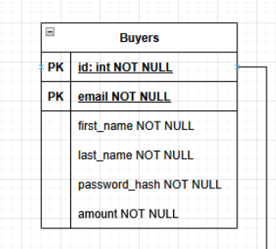
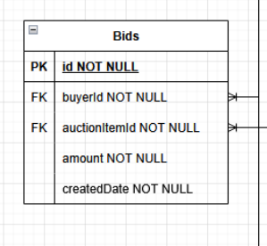
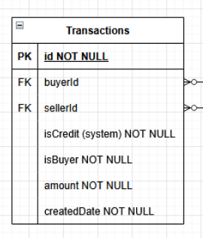
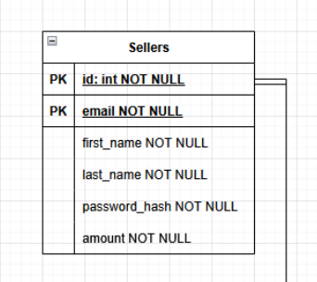
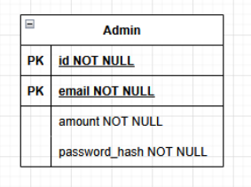
ER Diagram

Slide 7
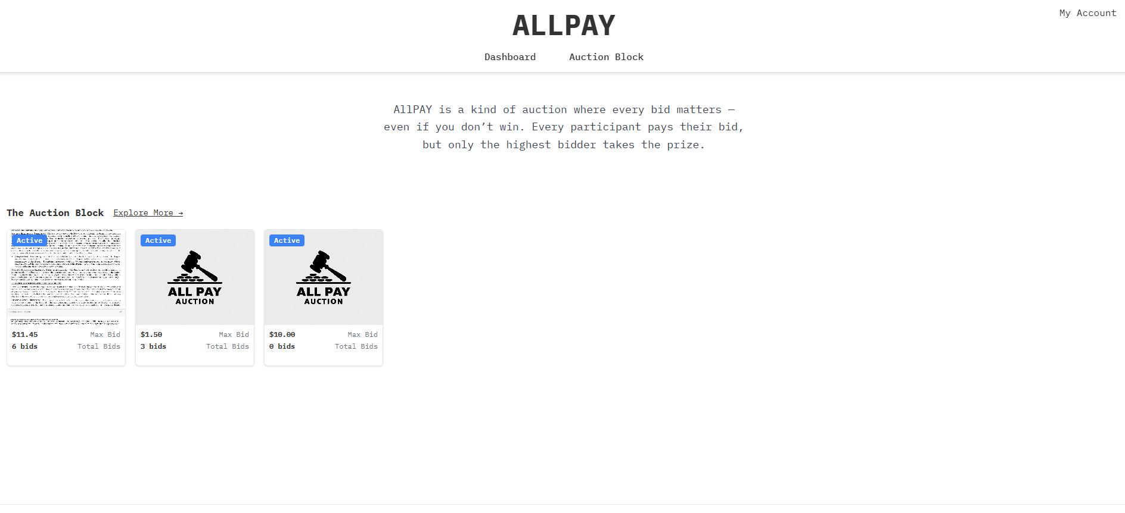
Landing Page
User/Seller Account
Active Bids

Slide 8
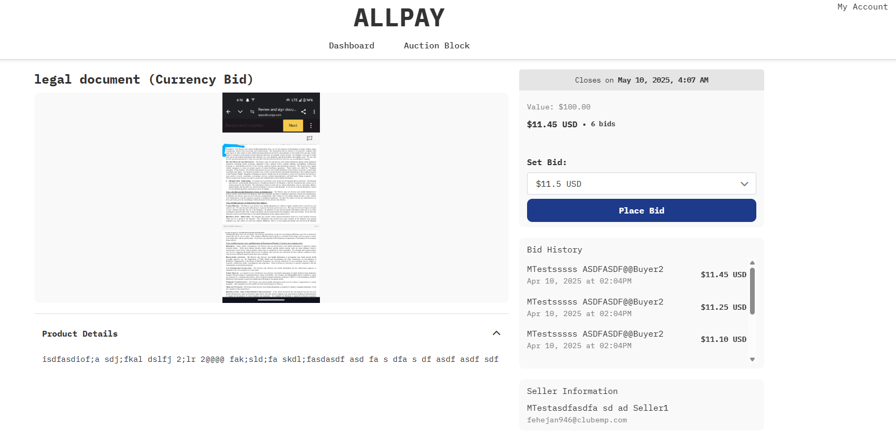
Active Bid (example)

Slide 9
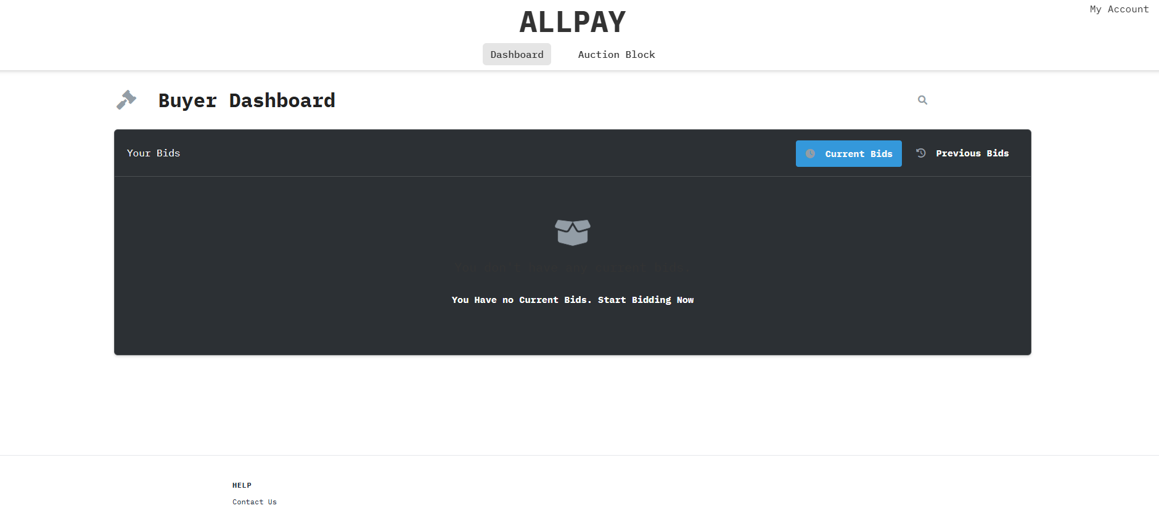
Dashboard

Slide 10
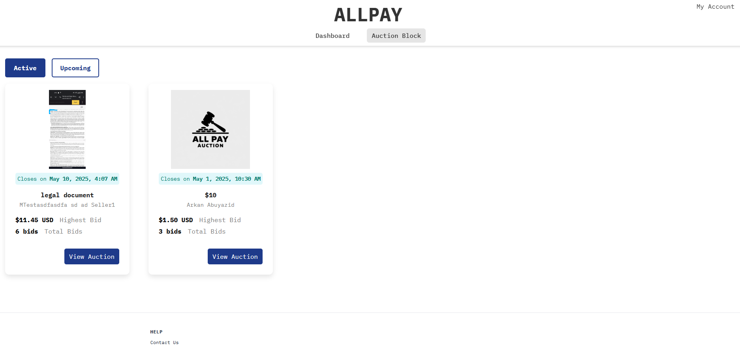
Auction Block Page

Slide 11
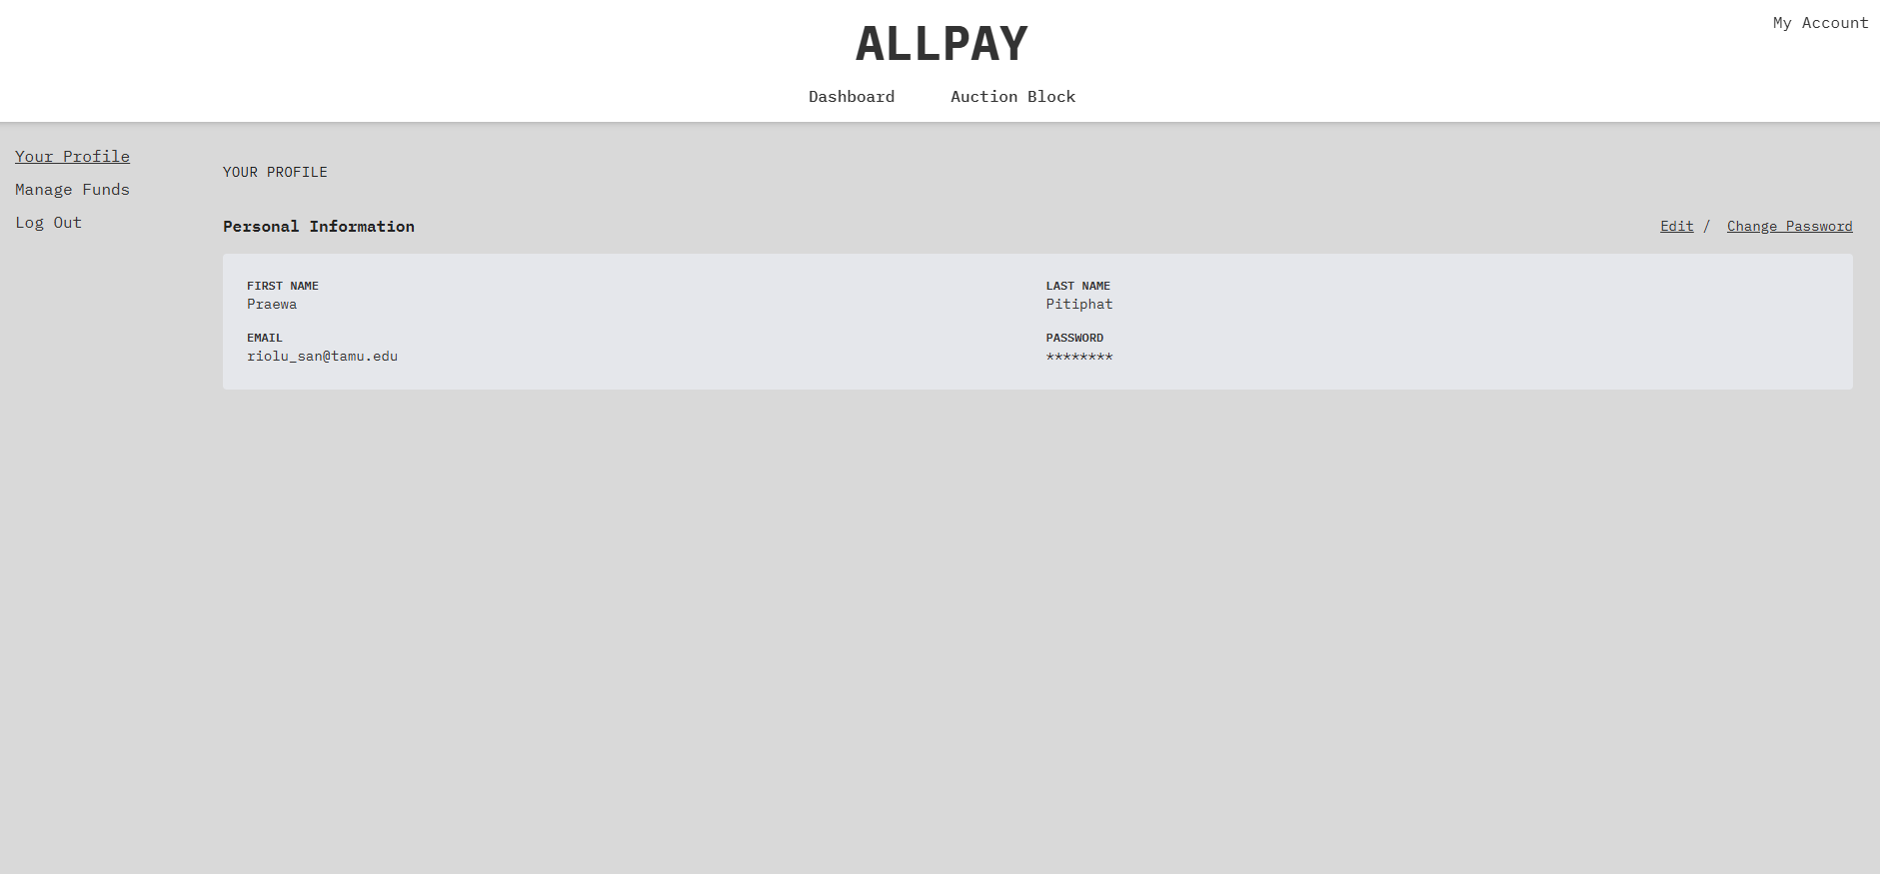
User Settings Page
User can add funds via
“Manage Funds”

Slide 12
Challenges and lessons we have learned about the software engineering process.

Slide 13
Challenges and lessons
Communication is a key: : Lack of clear and consistent communication among team members, stakeholders, and clients, resulting in misunderstandings and errors.
Technical Debt: Accumulating compromises and shortcuts in code or design that need to be addressed later, impacting maintainability and future development.
Set Realistic Expectations and Manage Them Proactively: Involve stakeholders in planning and clearly communicate potential risks and limitations.
Implement Comprehensive Testing Strategies: Employ various testing methods throughout the development lifecycle to identify and fix issues early.

Slide 14
Demo

Slide 15
Thank you!

Slide 16
Links
Heroku Deployment: https://all-pay-auction3-478f271f12bd.herokuapp.com/
Project repository: https://github.com/SIRL-TAMU/all-pay-auction

